Slide 1
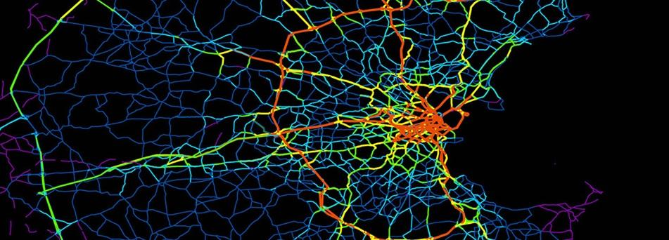
Texas Traffic Trends
Stops and Accidents from 2010 to 2017

Slide 2

The Data

Slide 3

Crash Records Information System (C.R.I.S)
https://cris.dot.state.tx.us/public/Query/app/public/welcome
Information on vehicle accidents from 2010-2017
Injuries/Deaths, Speed Limit, Weather Condition
Victim Age/Ethnicity/Gender, Seat Position
Time, Day of Week, Latitude/Longitude

Slide 4
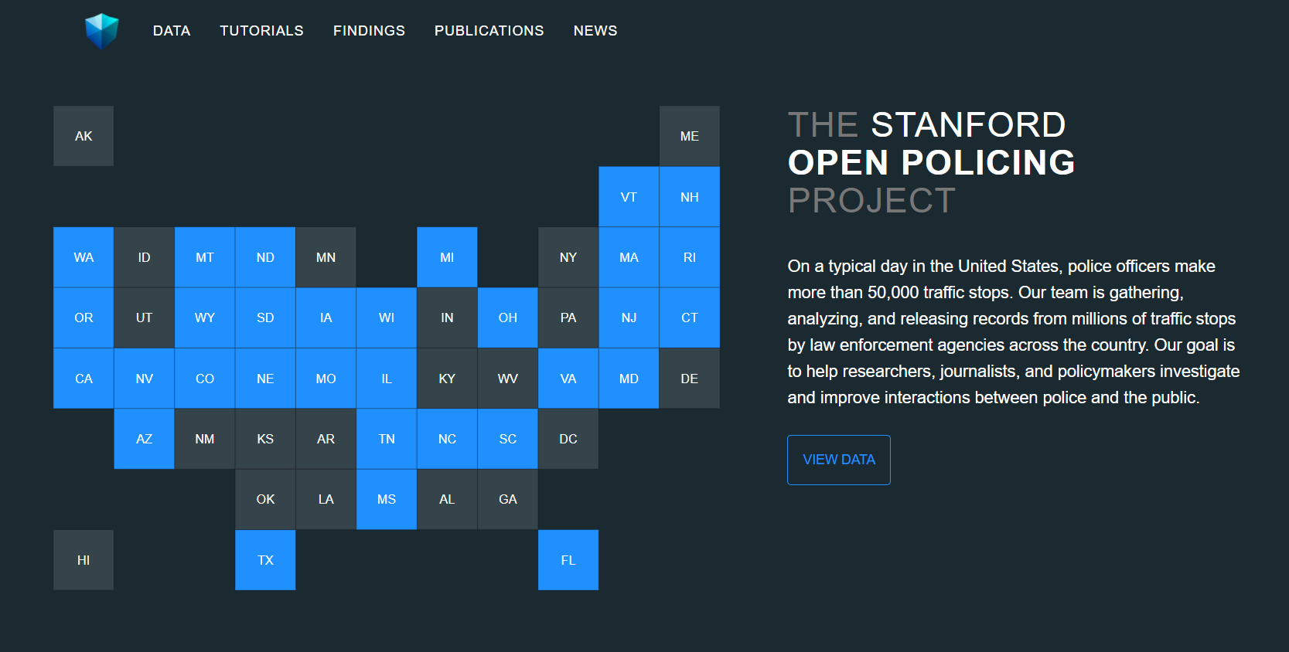
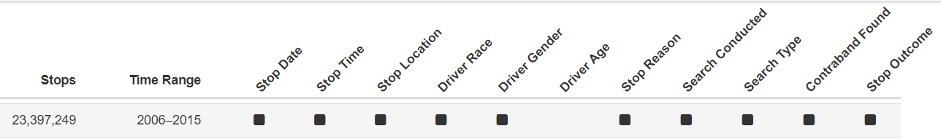
Stanford Open Policing Project
https://openpolicing.stanford.edu/data/
Information on police stops collected from across the country, varying in scope depending on state
Data available for Texas:

Slide 5
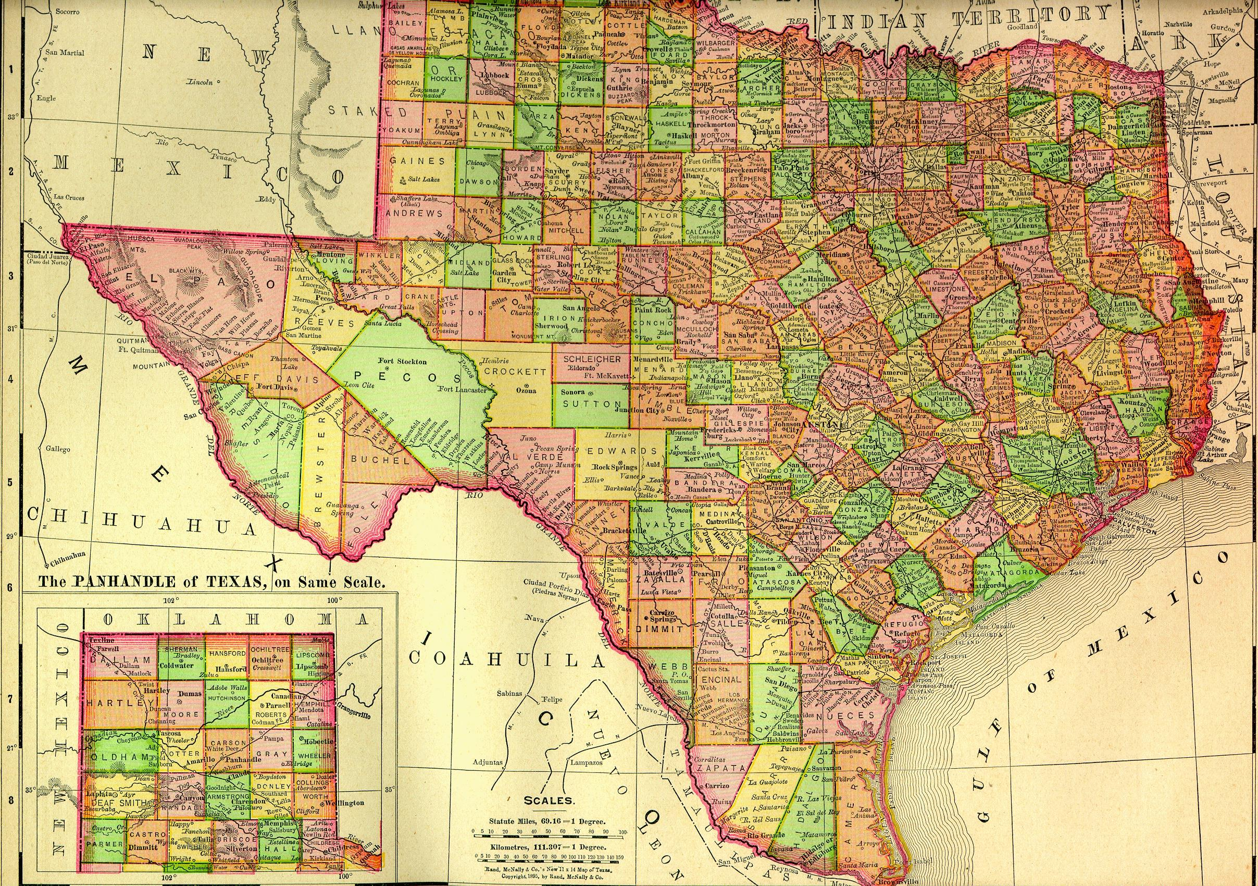
County Crashers

Slide 6
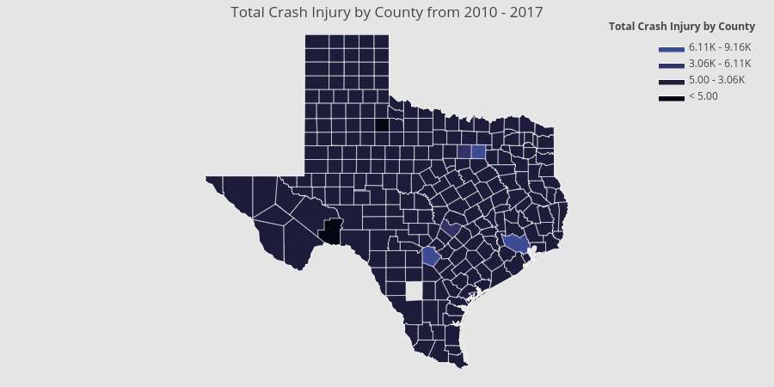

Slide 7
County Crashers
This heat map shows that the highest concentration of injuries from traffic accidents takes place around the metropolitan areas of Houston, Dallas, and San Antonio.

Slide 8

Under the Weather

Slide 9
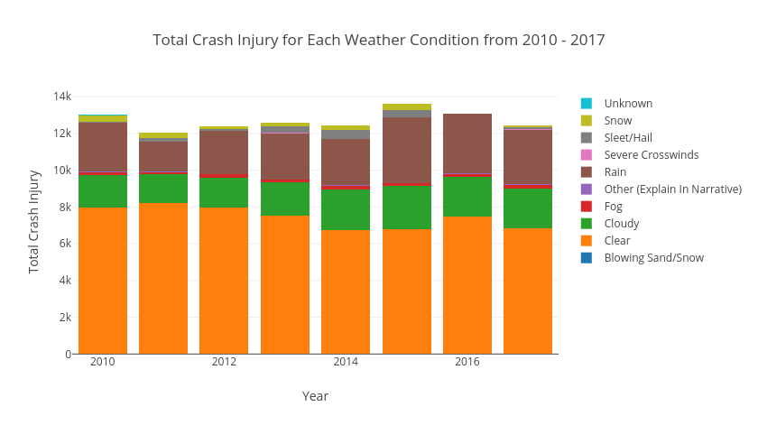

Slide 10
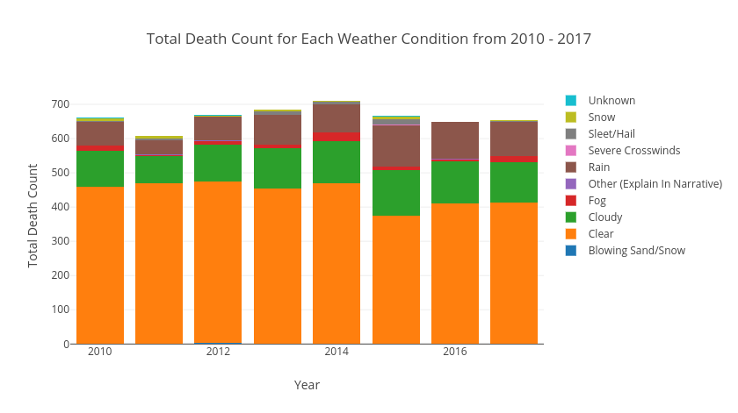

Slide 11
Under the Weather
While the majority of accident injuries/deaths occur on a clear day, there are more injuries recorded on rainy days than cloudy.
Snow injuries are a small but consistent presence from 2010-2015, but see a sharp drop to nearly nothing in 2016 and 2017.

Slide 12

Stopping Speeders

Slide 13
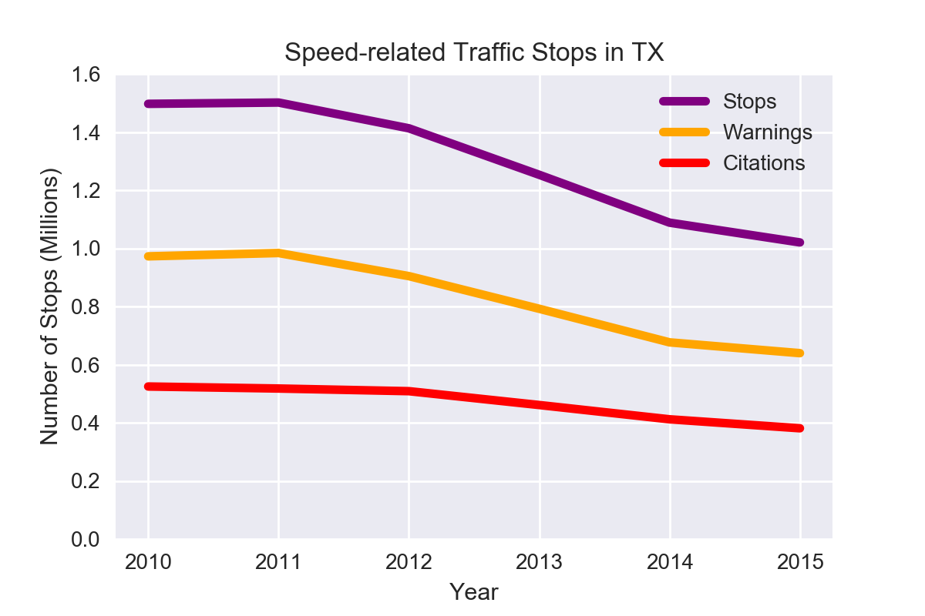

Slide 14
Stopping Speeders
Overall, traffic stops citing speed as a reason for the stop have decreased by about 30%
While the number of warnings given out as a result has decreased at a similar rate (slightly over 30%), the number of citations given has seen a much smaller drop, by only around 20%

Slide 15
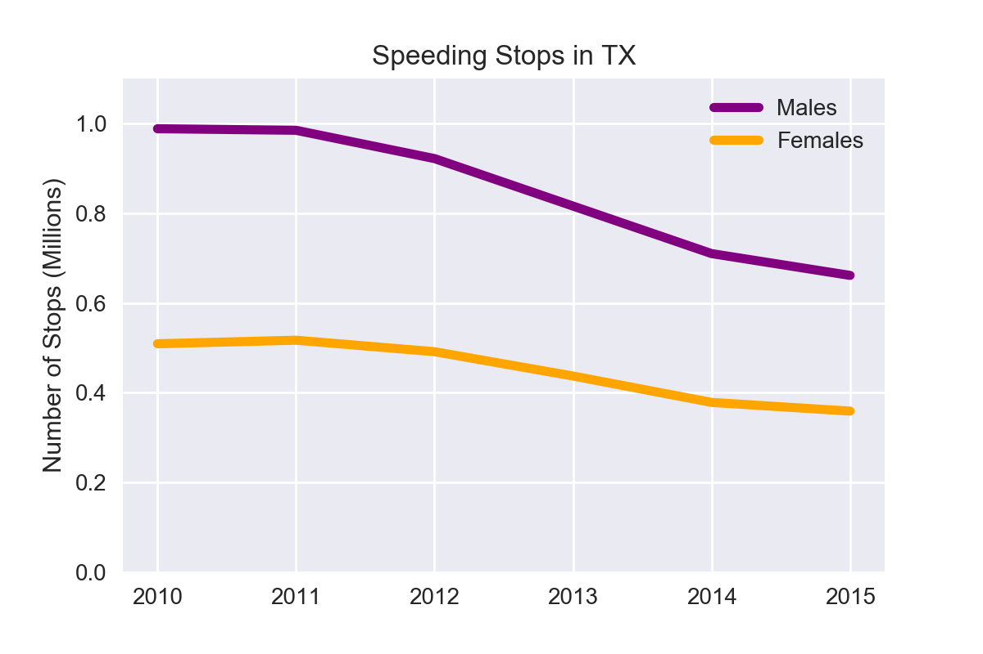
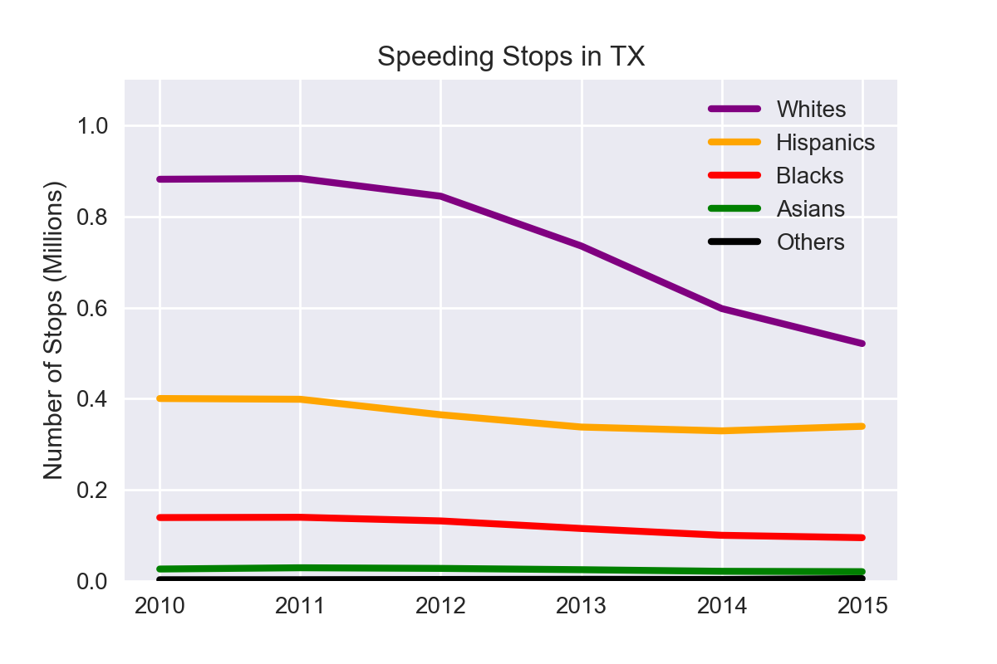

Slide 16
Stopping Speeders
While men saw a slightly larger drop in number of speeding stops than women, the sharpest discrepancy is apparent in the racial breakdown, where we can see that minorities races remain relatively consistent in their number of stops while slightly more than half as many white people were stopped in 2015 as in 2010.

Slide 17
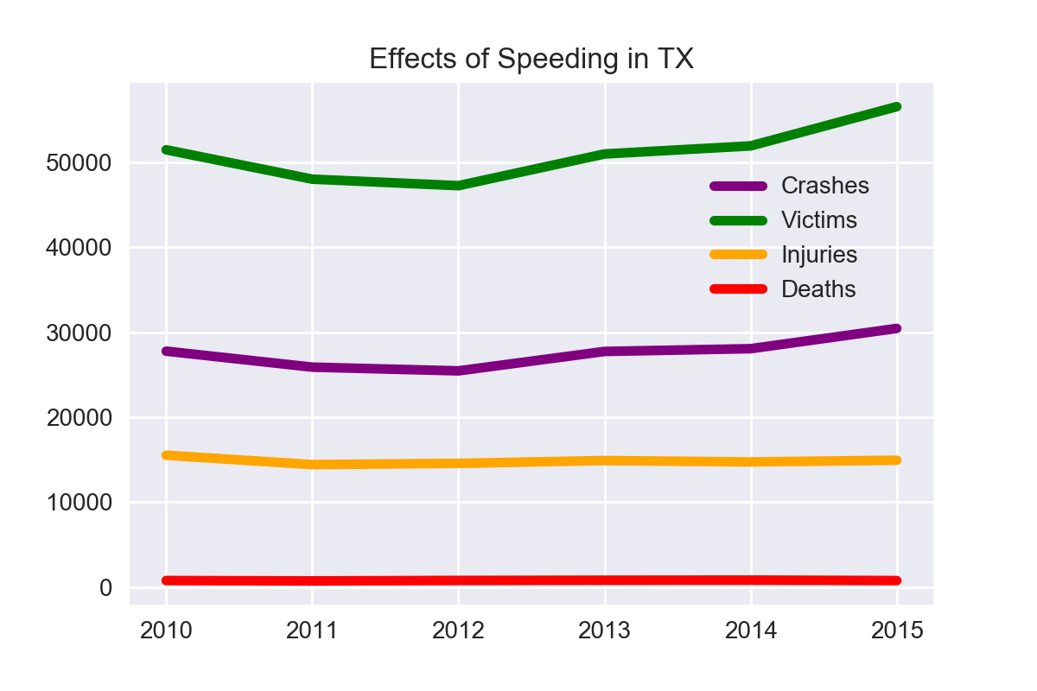

Slide 18
Stopping Speeders
While the number of injuries and deaths due to accidents where speed was a factor remained relatively stable, there is a clear upwards trend on the number of accidents and victims involved.
Further research into other states might support or refute an inverse relationship between number of warnings given out and minor accidents (without injury).

Slide 19
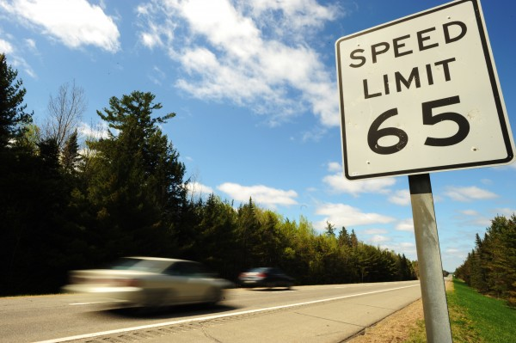
Pushing the Limits

Slide 20
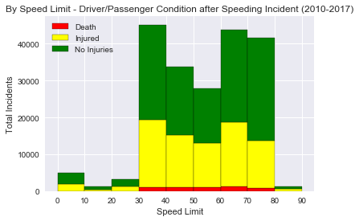

Slide 21
Pushing the Limits
There is a dramatic increase in both accidents and their fatality as soon as the posted speed limit hits 30 MPH.
Comparing these numbers with each speed limit’s total road miles within Texas could help identify any particularly deadly speed limits.
Data Source: C.R.I.S 2010-2017

Slide 22
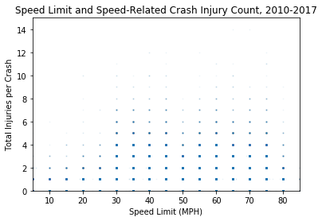

Slide 23
Pushing the Limits
While the majority of speed-related crashes did not involve injury, areas with a posted speed limit under 30 MPH very rarely saw accidents with more than two injuries, with another dramatic increase at limits of 30 or higher.
Data Source: C.R.I.S 2010-2017

Slide 24

Slowing Down with Age

Slide 25
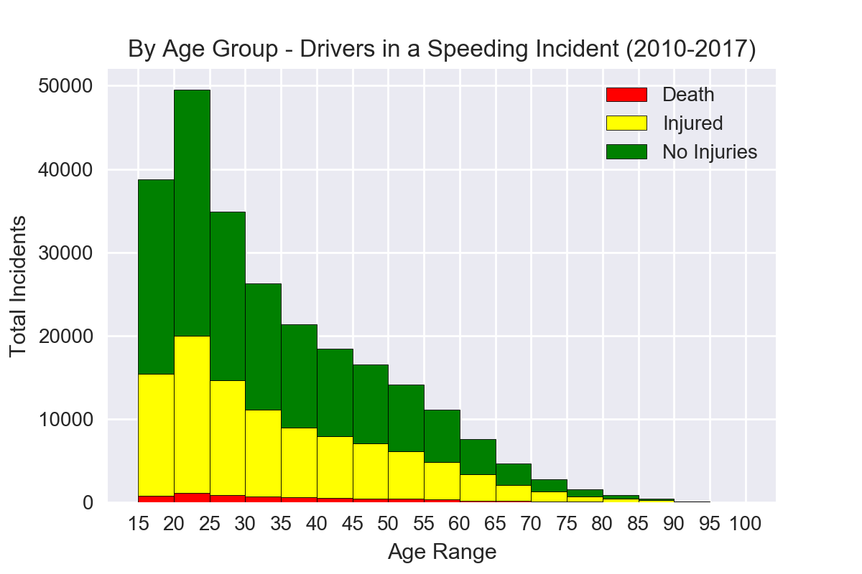

Slide 26
Slowing Down with Age
Drivers involved in speed-related crashes overwhelmingly tend to be under 30, with the peak range from 20-25 years old.

Slide 27
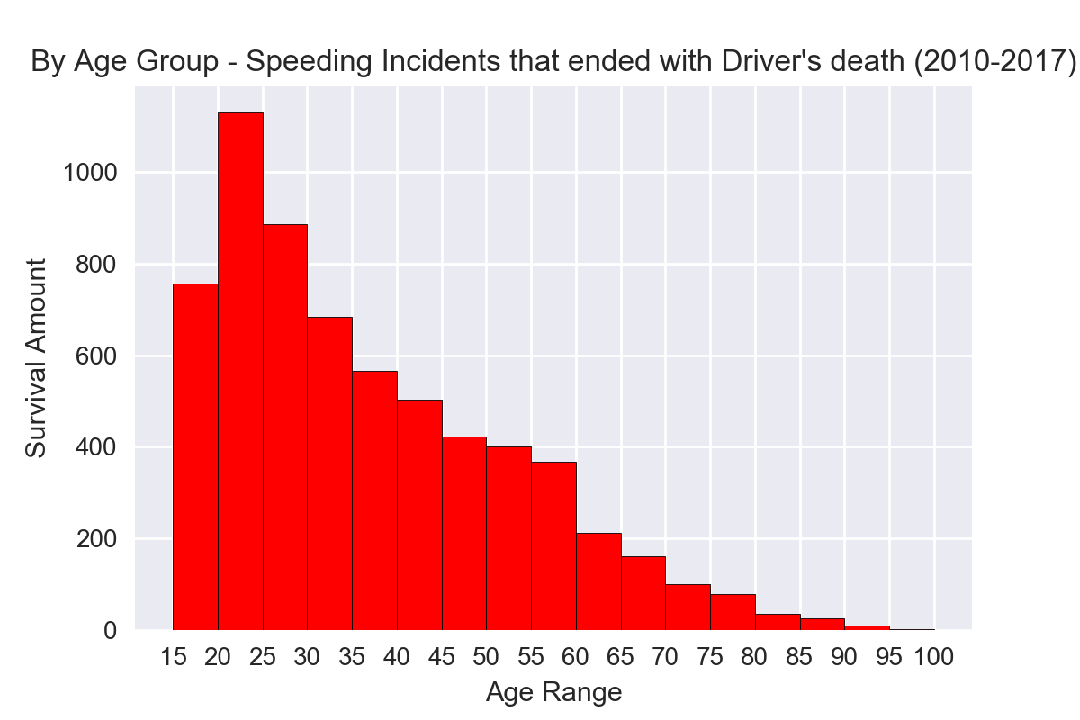

Slide 28
Slowing Down with Age
When focused on driver deaths, however, drivers under 20 seem to be less likely to lose their life than other age groups when involved in speed-related accidents

